Slide 1

Basic Details of the Team and Problem Statement
Ministry/ Organization Name: Defence Research and
Development Organization (DRDO),Ministry of Defence
Problem Statement: Solution to Identify drones through CCTV feeds installed at houses, roads etc.
T eam Name: BlackAtom
T eam Leader Name: Shlok Nandurbarkar Institute Code : 045
Institute Name: Shri S’ad Vidya Mandal Institute of
Technology

Slide 2
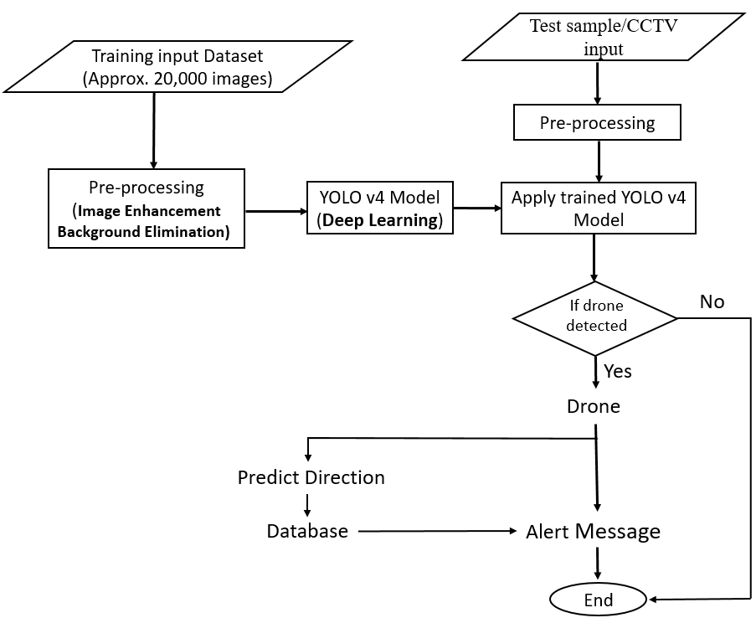
Idea/Approach Details
Add process flow chart or simulated image of prototype or any relevant image related to your idea
Describe your idea/Solution/Prototype here:
Detecting the drones from camera’s frame using Deep Learning
Algorithm :
For this we use YOLOv4(Deep Learning) Algorithm
We use CUDA and cu-DNN for GPU acceleration in the model training, testing and implementation.
Determining movement of the detected drone for all possible axis :
Detection box area difference
Measurement(approaching/retreading)
X axis, Y axis variation (Left/Right/Up/Down) movement
On confident detection alert the concerned authority.
Describe your Technology stack here:
Python
TensorFlow
CUDA, cu-DNN
OpenCV

Slide 3
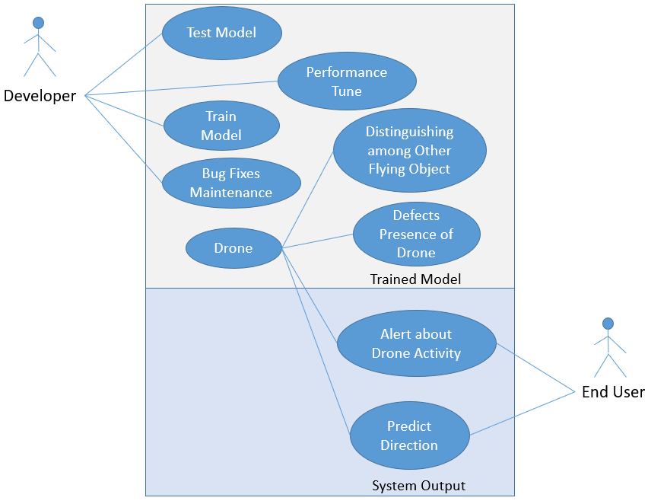
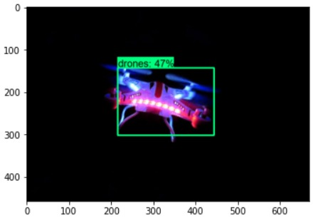
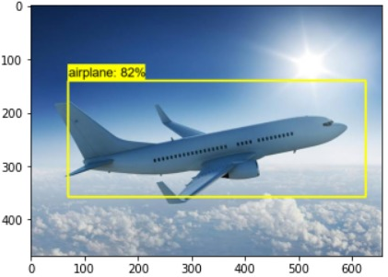
Idea/Approach Details
Describe your Use Cases here
Describe your Dependencies / Show stopper here
CCTV cameras for input
Trained model which distinguishes between different objects and helps to detect the drone.
Image enhancement algorithm enhances the images from CCTV camera, which makes the results more accurate.
Alert system alerts the responsible authority if drone or any other suspected objects are detected.
3

